Slide 1


Diogo Monteiro
17/02/2025

Slide 2

Outline
Executive Summary
Introduction
Methodology
Results
Conclusion
Appendix

Slide 3
Executive Summary
Summary of methodologies
Data Collection via API, Web Scraping
Exploratory Data Analysis (EDA) with Data Visualization
EDA with SQL
Interactive Map with Folium
Dashboards with Plotly Dash
Predictive Analysis
Summary of all results
Exploratory Data Analysis results Interactive maps and dashboard
Predictive results

Slide 4
Introduction
Project background and context
This project aims to predict whether the Falcon 9 first stage will successfully land. According to SpaceX, a Falcon 9 launch costs $62 million, whereas other providers charge over $165 million per launch. SpaceX’s ability to reuse the first stage is the key reason for this cost difference. By predicting the likelihood of a successful landing, we can estimate launch costs, which is valuable information for companies looking to compete with SpaceX in the rocket launch industry.
Problems you want to find answers
What key factors differentiate a successful landing from a failed one?
How do various rocket-related variables impact the likelihood of a successful landing?
What conditions must be met for SpaceX to maximise its landing success rate?

Slide 5

Section 1

Slide 6
Methodology
Executive Summary
Data collection methodology:
SpaceX REST API
Web Scrapping from Wikipedia
Perform data wrangling
Dropping unnecessary columns
One Hot Encoding for Classification Models
Perform exploratory data analysis (EDA) using visualisation and SQL
Perform interactive visual analytics using Folium and Plotly Dash
Perform predictive analysis using classification models
How to build, tune, and evaluate classification models

Slide 7
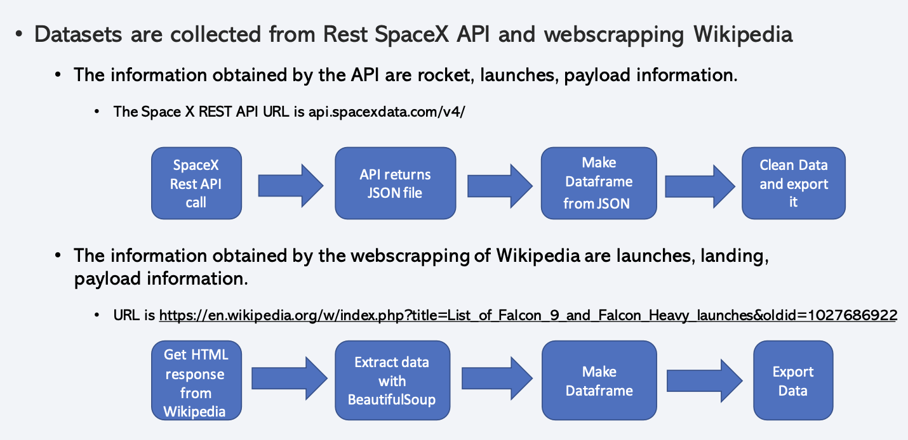
Data Collection

Slide 8
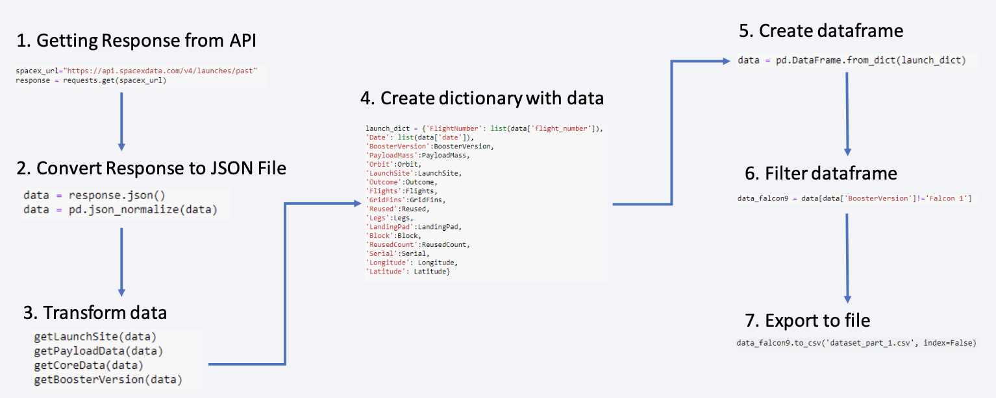
Data Collection – SpaceX API

Slide 9
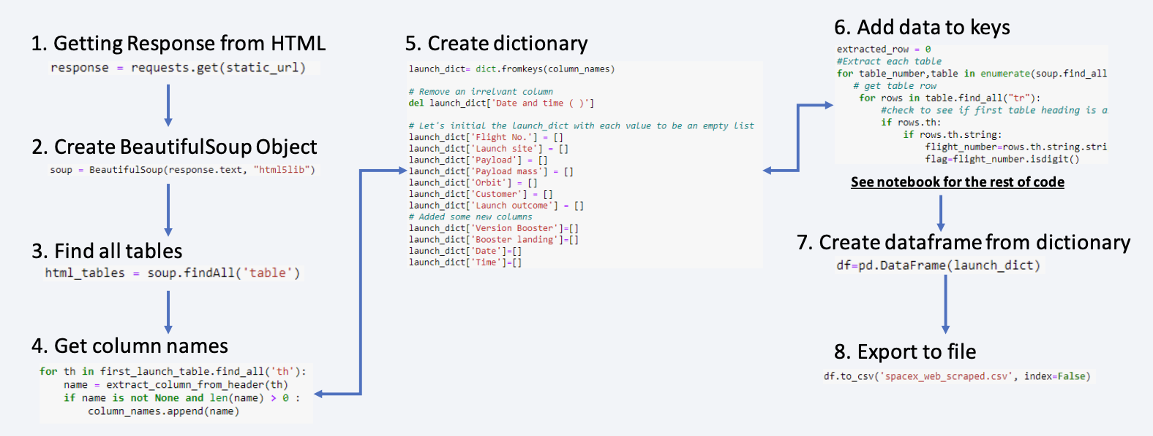
Data Collection - Scraping

Slide 10
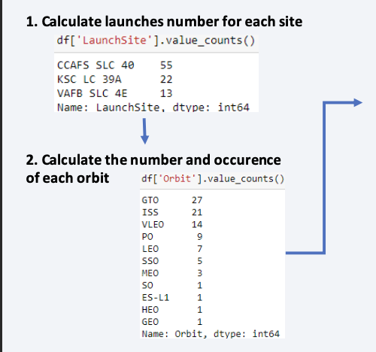
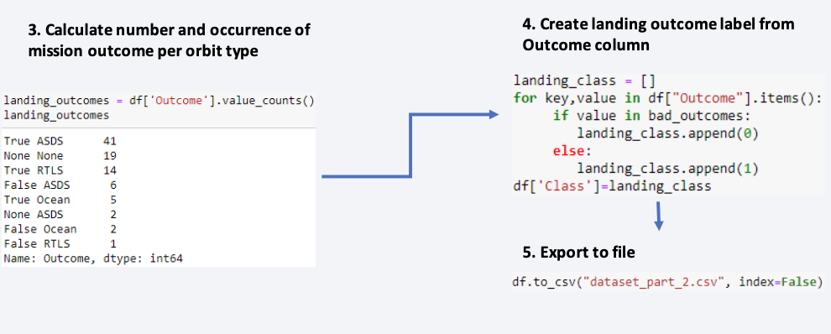
Data Wrangling
In the dataset, there are several cases where the booster did not land successfully.
True Ocean, True RTLS, True ASDS means the mission has been successful.
False Ocean, False RTLS, False ASDS means the mission was a failure.
We need to transform string variables into categorical variables where 1 means the mission has been successful and 0 means the mission was a failure.

Slide 11
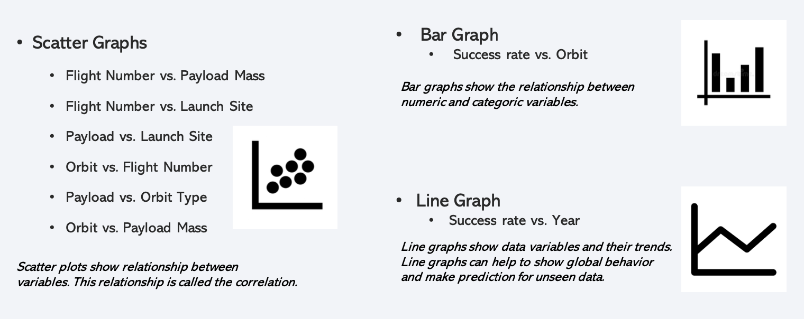
EDA with Data Visualization

Slide 12
EDA with SQL
• We performed SQL queries to gather and understand data from dataset:
• Displaying the names of the unique launch sites in the space mission.
• Display 5 records where launch sites begin with the string 'CCA'
• Display the total payload mass carried by NASA (CRS) boosters.
• Display average payload mass carried by booster version F9 v1.1.
• List the date when the first successful landing outcome in the ground pad was achieved.
• List the names of the boosters which have success in drone ship and have payload mass greater than 4000 but less than 6000.
• List the total number of successful and failed mission outcomes.
• List the names of the booster_versions which have carried the maximum payload mass.
• List the records which will display the month names, failure landing_ouutcomes in drone ship, booster versions, and launch_site for the months in 2015.
• Rank the count of successful landing_outcomes between the dates 04-06-2010 and 20-03-2017 in descending order.

Slide 13
Build an Interactive Map with Folium
• Folium map object is a map centered on NASA Johnson Space Center at Houston, Texas
• Red circle at NASA Johnson Space Center's coordinate with the label showing its name (folium.Circle, folium.map.Marker).
• Red circles at each launch site coordinates with the label showing the launch site name (folium.Circle, folium.map.Marker,
folium.features.DivIcon).
• The grouping of points in a cluster to display multiple and different information for the same coordinates
(folium.plugins.MarkerCluster).
• Markers to show successful and unsuccessful landings. Green for successful landing and Red for unsuccessful landing.
(folium.map.Marker, folium.Icon).
• Markers to show the distance between the launch site to key locations (railway, highway, coastway, city) and plot a line between them.
( folium.map.Marker, folium.PolyLine, folium.features.DivIcon)
• These objects are created to understand better the problem and the data. We can easily show all launch sites, their surroundings and the number of successful and unsuccessful landings.

Slide 14
Build a Dashboard with Plotly Dash
• Dashboard has dropdown, pie chart, rangeslider and scatter plot components
• Dropdown allows a user to choose the launch site or all launch sites
(dash_core_components.Dropdown) .
• Pie chart shows the total success and the total failure for the launch site chosen with the
dropdown component (plotly.express.pie) .
• Rangeslider allows a user to select a payload mass in a fixed range
( dash_core_components.RangeSlider) .
• Scatter chart shows the relationship between two variables, in particular Success vs
Payload Mass ( plotly.express.scatter) .

Slide 15
Predictive Analysis (Classification)
• Data preparation
• Load dataset
• Normalize data
• Split data into training and test sets.
• Model preparation
• Selection of machine learning algorithms
• Set parameters for each algorithm to GridSearchCV
• Training GridSearchModel models with training dataset
• Model evaluation
• Get best hyperparameters for each type of model
• Compute accuracy for each model with test dataset
• Plot Confusion Matrix
• Model comparison
• Comparison of models according to their accuracy
• The model with the best accuracy will be chosen (see Notebook for result)

Slide 16
Results
Exploratory data analysis results
Interactive analytics demo in screenshots
Predictive analysis results

Slide 17

Section 2

Slide 18
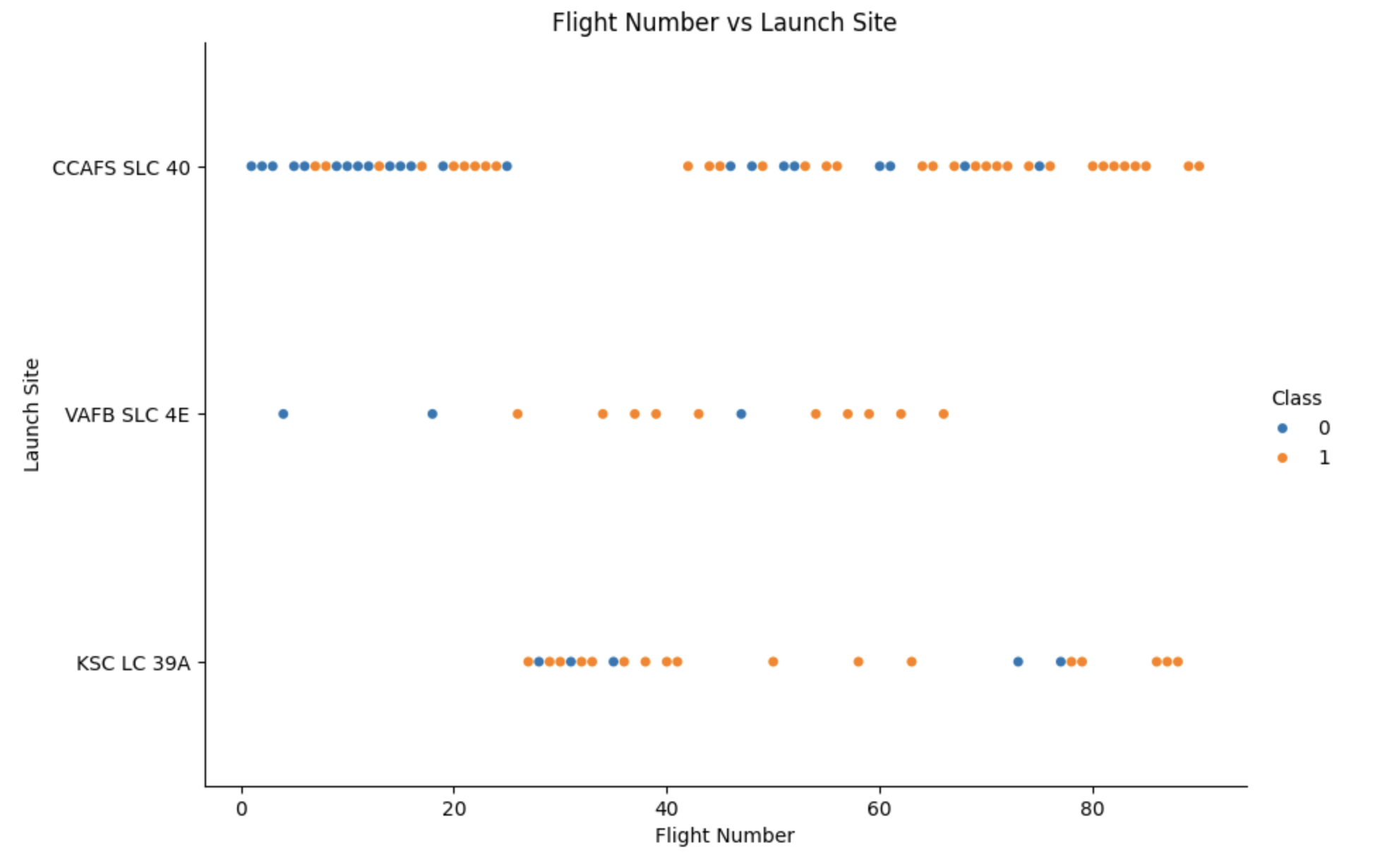
Flight Number vs. Launch Site
We observe that, for each site, the success rate is increasing.

Slide 19
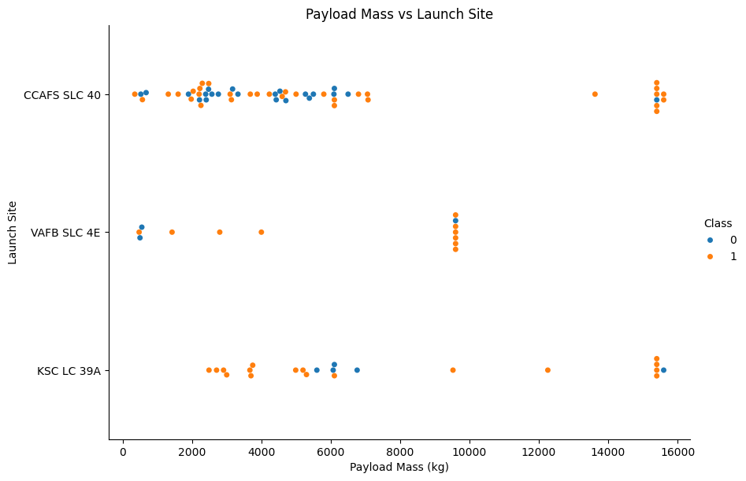
Payload vs. Launch Site
Depending on the launch site, a heavier payload may be a consideration for a successful landing.
On the other hand, a payload that is too heavy can cause a landing to fail.

Slide 20
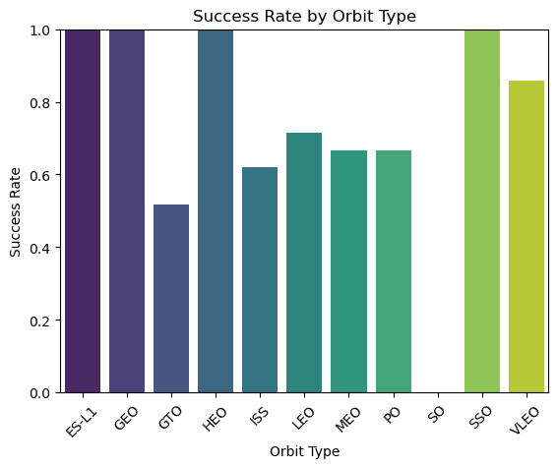
Success Rate vs. Orbit Type
It can be observed that ES-L1, GEO, HEO, and SSO have the best success rate.

Slide 21
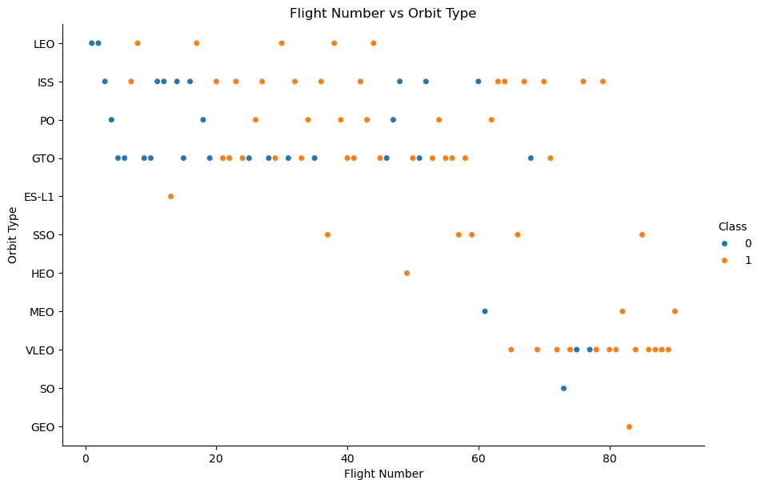
Flight Number vs. Orbit Type
We notice that the success rate increases with the number of flights for the LEO orbit. For some orbits like
GTO, there is no relation between the success rate and the number of flights. But we can suppose that the
high success rate of some orbits like SSO or HEO is due to the knowledge learned during former launches
for other orbits.

Slide 22
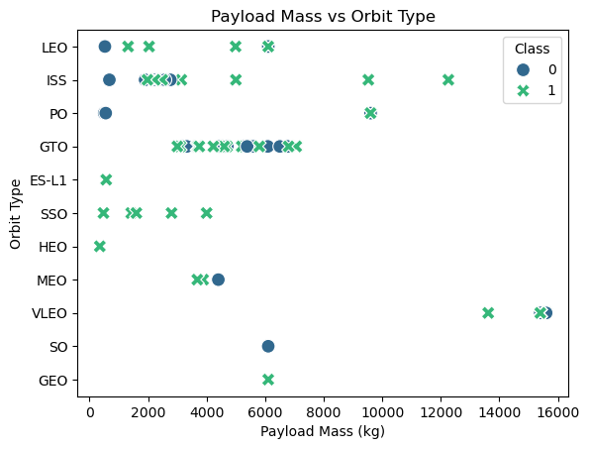
Payload vs. Orbit Type
The weight of the payloads can have a great influence on the success rate of the launches in certain
orbits. For example, heavier payloads improve the success rate for the LEO orbit. Another finding is that
decreasing the payload weight for a GTO orbit improves the success of a launch.

Slide 23
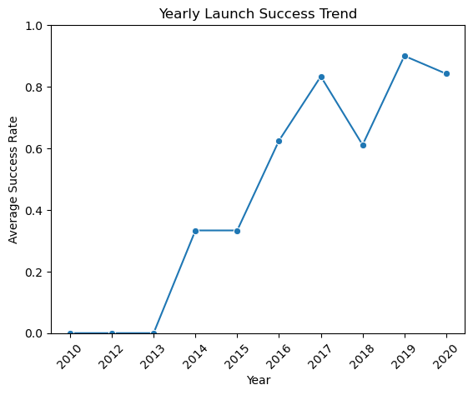
Launch Success Yearly Trend
Since 2013, we can see an increase in the Space X Rocket success rate.

Slide 24
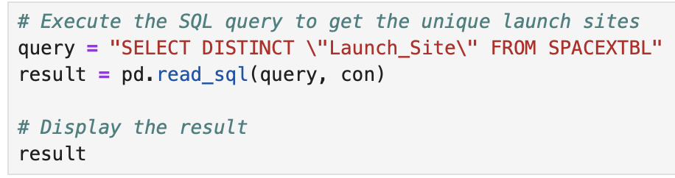
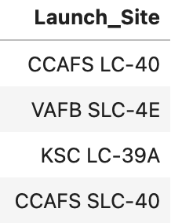
All Launch Site Names
SQL Query
Results
Explanation
Using DISTINCT in the query ensures that duplicate values in the LAUNCH_SITE column are removed, returning only unique launch site names.

Slide 25
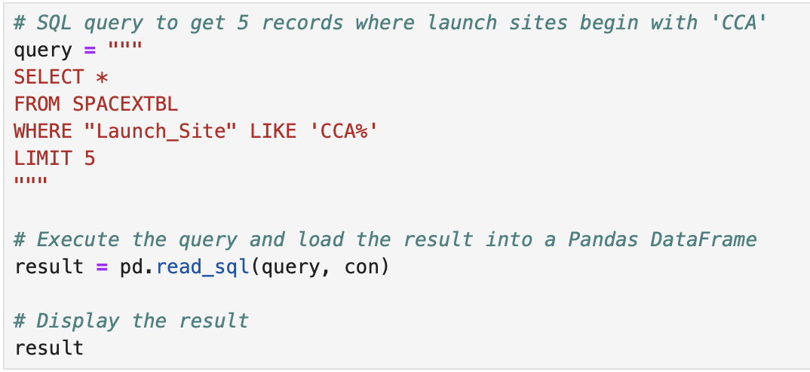
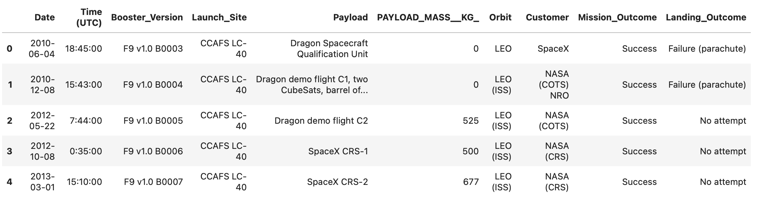
Launch Site Names Begin with 'CCA'
The WHERE clause followed by LIKE clause filters
launch sites that contain the substring CCA.
LIMIT 5 shows 5 records from filtering.

Slide 26
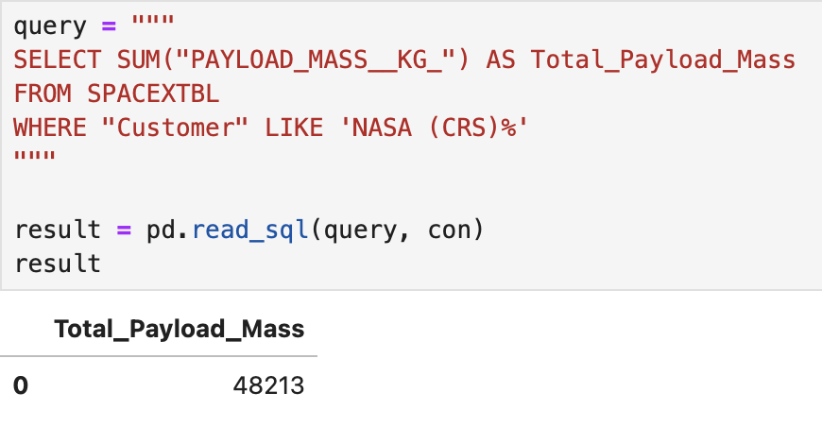
Total Payload Mass
This query returns the sum of all payload masses
where the customer is NASA (CRS).

Slide 27
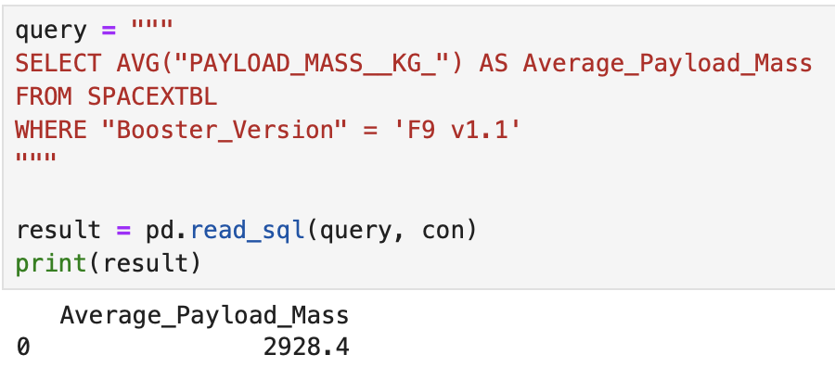
Average Payload Mass by F9 v1.1
This query returns the average of all payload masses where the booster version contains the substring F9 v1.1

Slide 28
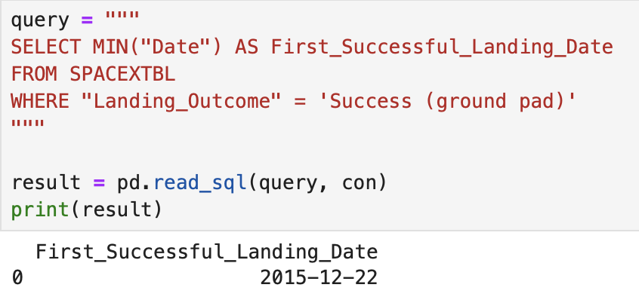
First Successful Ground Landing Date
With this query, we select the oldest successful landing. The WHERE clause filters dataset in order to keep only records where landing was successful. With the MIN function, we select the record with the oldest date.

Slide 29
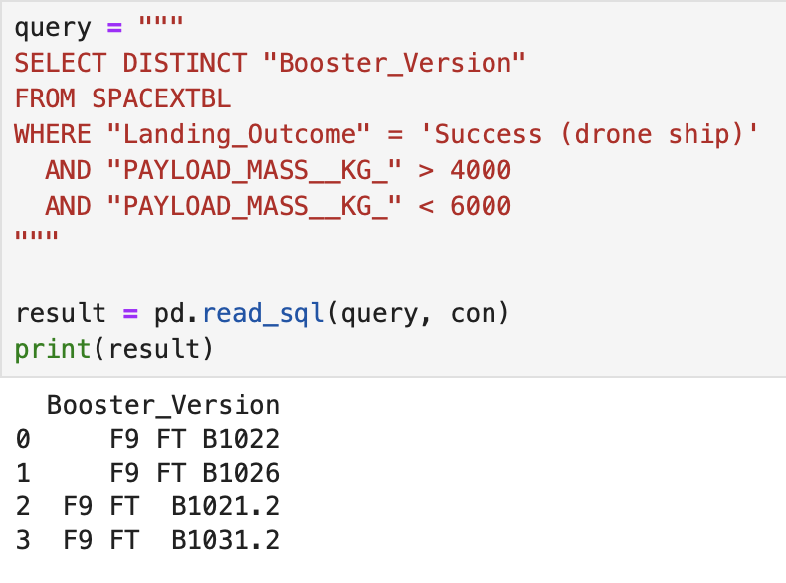
Successful Drone Ship Landing with Payload between 4000 and 6000
This query returns the booster version where the landing was successful and the payload mass is between 4000 and 6000 kg. The WHERE and AND clauses filter the dataset.

Slide 30
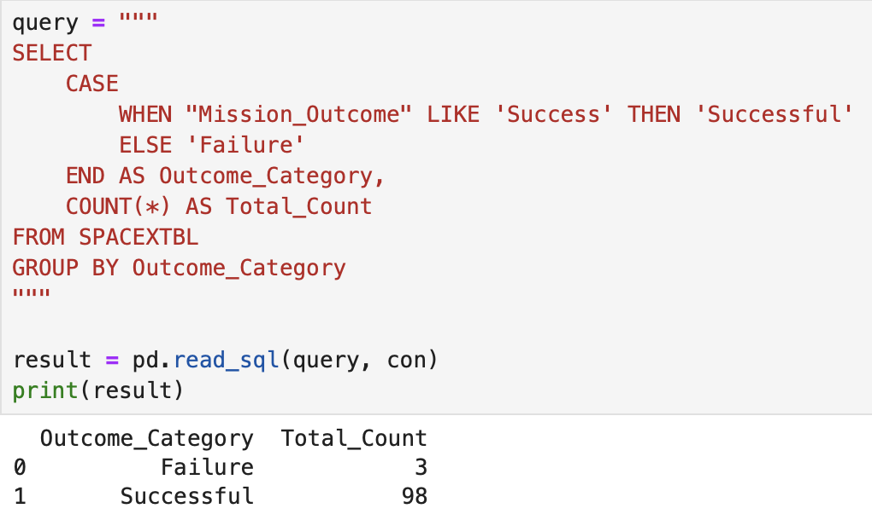
Total Number of Successful and Failure Mission Outcomes
With the first SELECT, we show the subqueries that return results. The first subquery counts the successful mission. The second subquery counts the unsuccessful mission. The WHERE clause followed by the LIKE clause filters the mission outcome. The COUNT function counts records filtered.

Slide 31
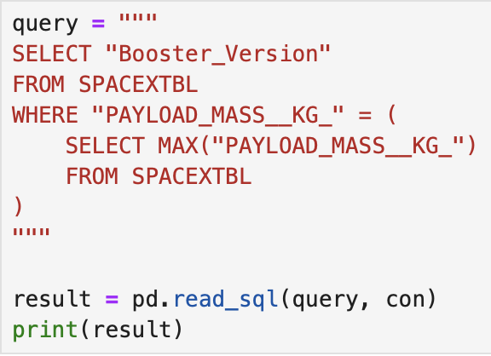
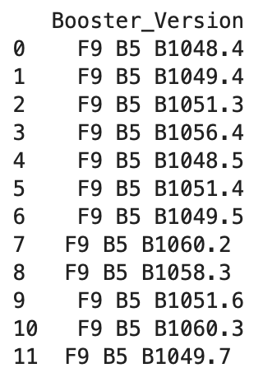
Boosters Carried Maximum Payload
We used a subquery to filter data by returning only the heaviest payload mass with the MAX function. The main query uses subquery results and returns a unique booster version with the heaviest payload mass.

Slide 32
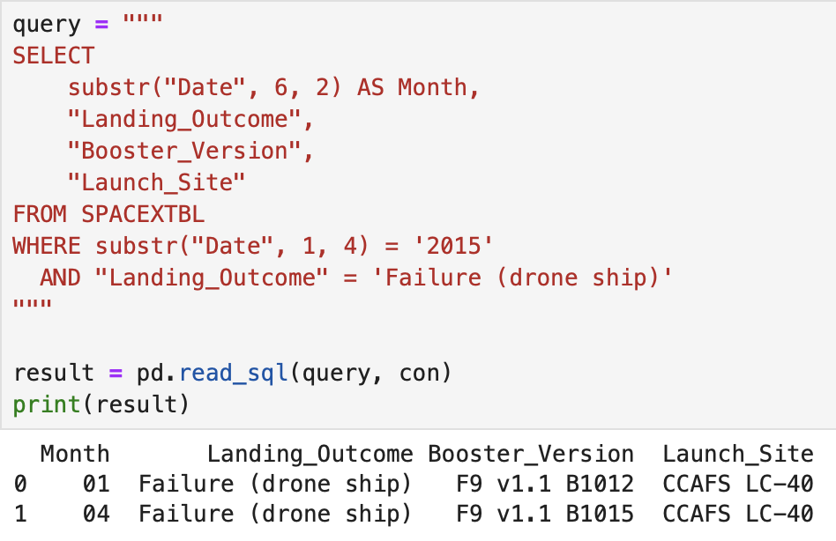
2015 Launch Records
This query returns a month, booster version, and launch site where the landing was unsuccessful, and the landing date took place in 2015. Substr function process date in order to take month or year. Substr(DATE, 4, 2) shows month. Substr(DATE,7, 4) shows year.

Slide 33
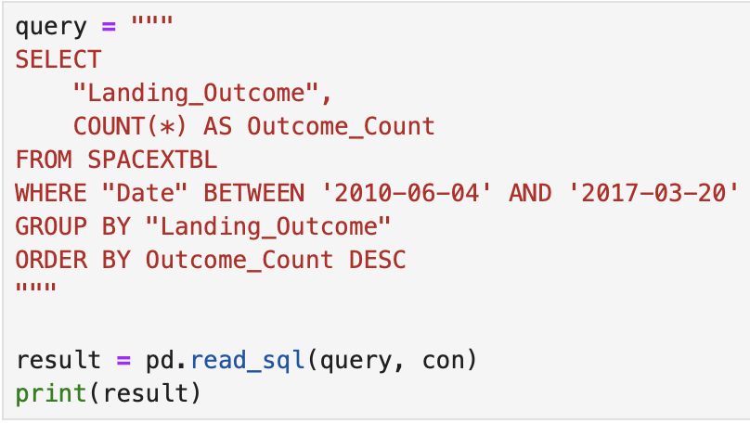
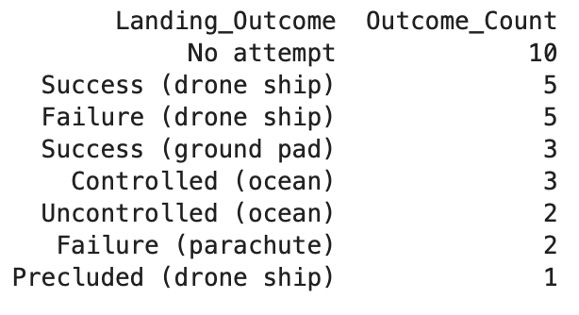
Rank Landing Outcomes Between 2010-06-04 and 2017-03-20
This query returns landing outcomes and their count where the mission was successful, and the date is between 04/06/2010 and 20/03/2017. The GROUP BY clause groups results by landing outcome, and the ORDER BY COUNT DESC shows results in decreasing order.

Slide 34

Section 3

Slide 35
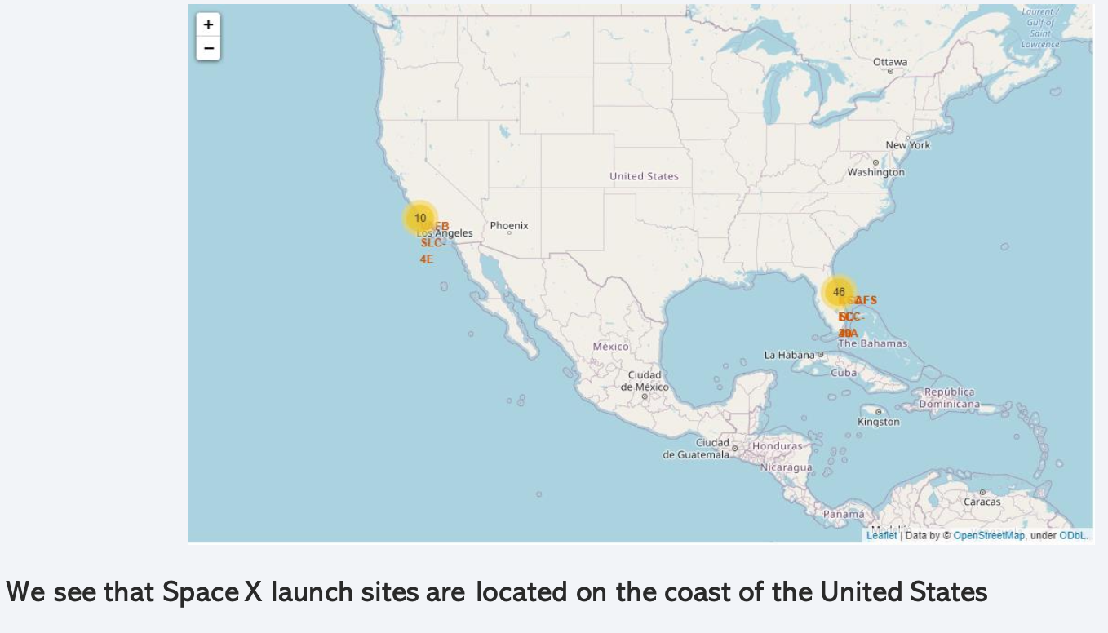
Folium map – Ground stations

Slide 36
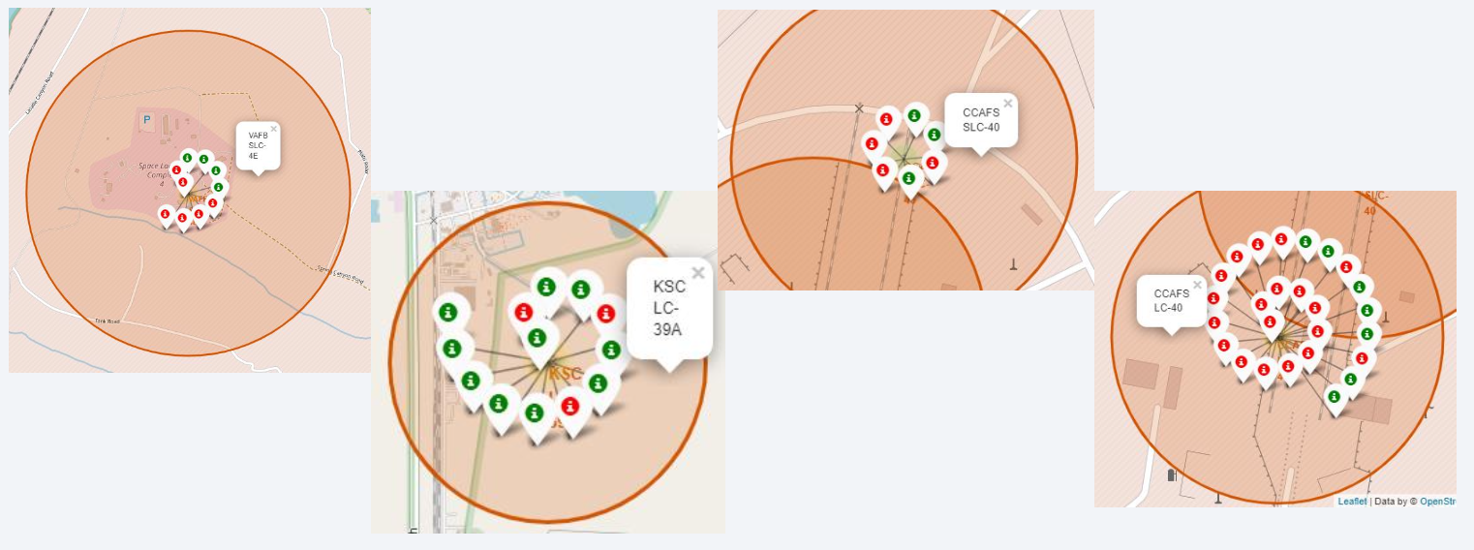
Folium map – Color Labeled Markers
The green marker represents successful launches. The Red marker represents unsuccessful launches.
We note that KSC LC-39A has a higher launch success rate.

Slide 37
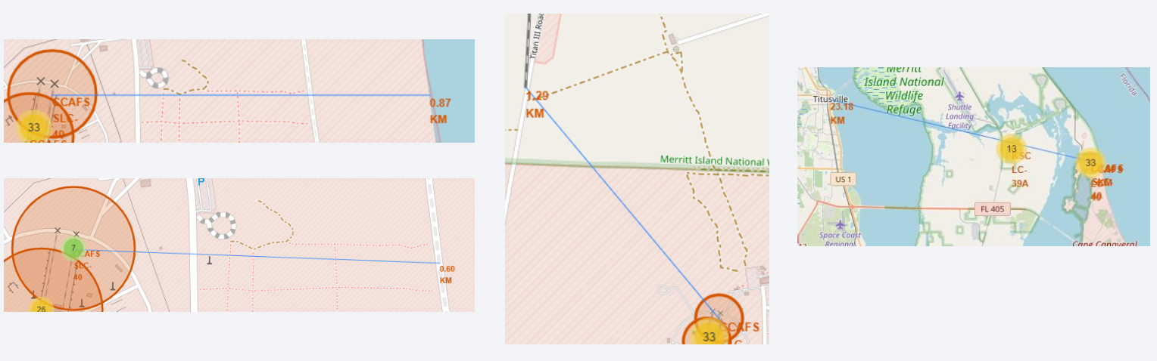
Folium Map – Distances between CCAFS SLC-40 and its proximities
Is CCAFS SLC-40 in close proximity to railways ? Yes
Is CCAFS SLC-40 in close proximity to highways ? Yes
Is CCAFS SLC-40 in close proximity to coastline ? Yes
Do CCAFS SLC-40 keeps certain distance away from cities ? No

Slide 38

Section 4

Slide 39
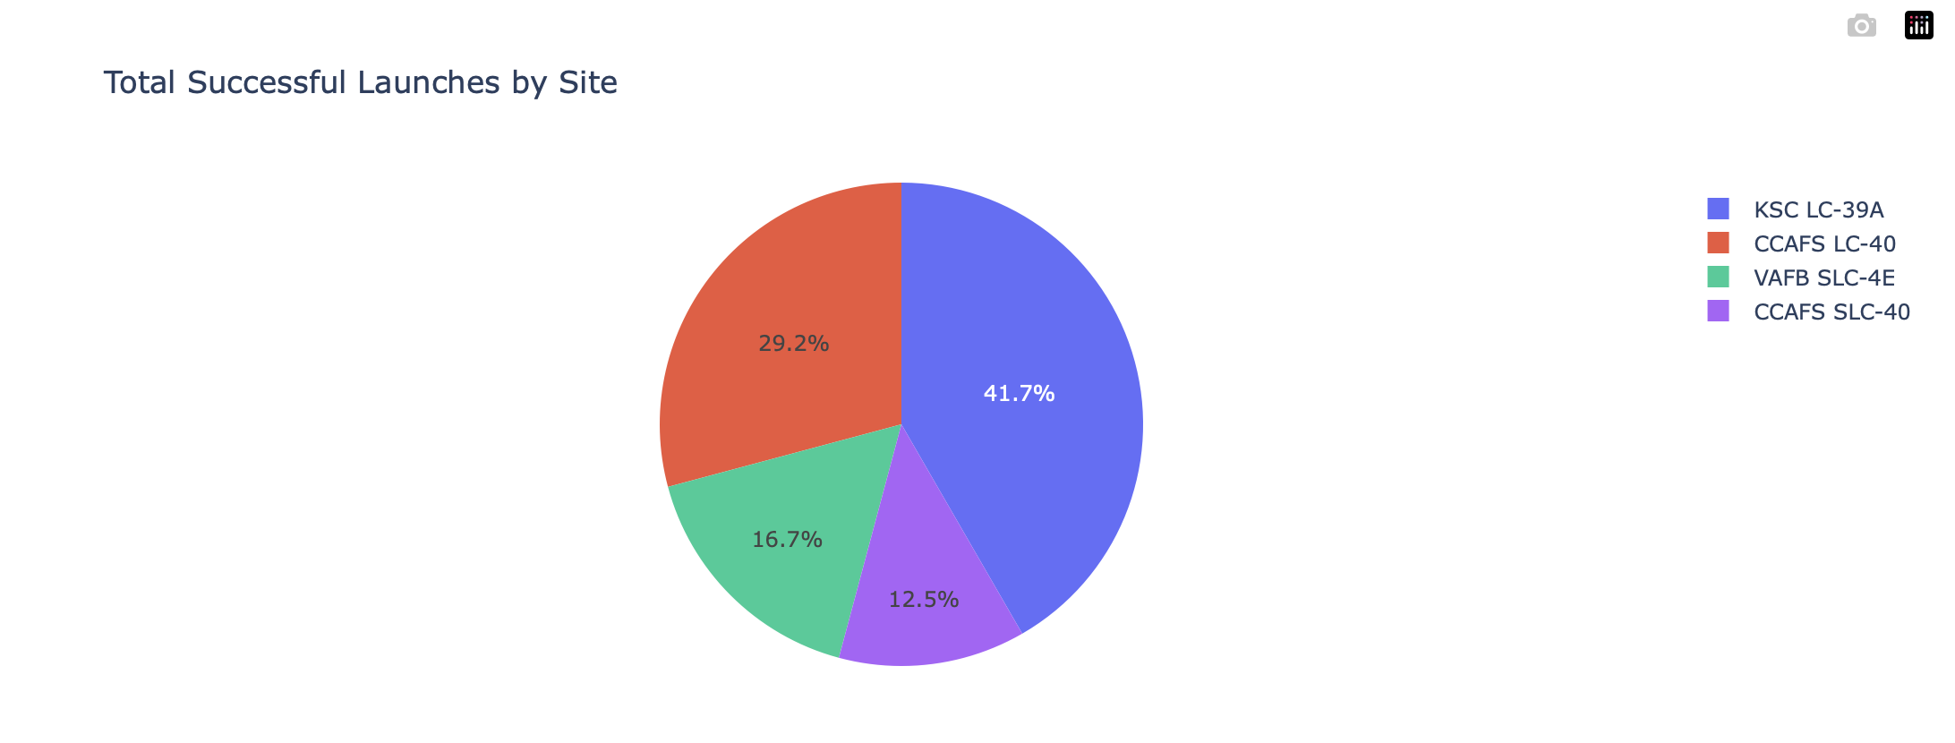
Dashboard – Total success by Site
We see that KSC LC-39A has the best success rate of launches.

Slide 40
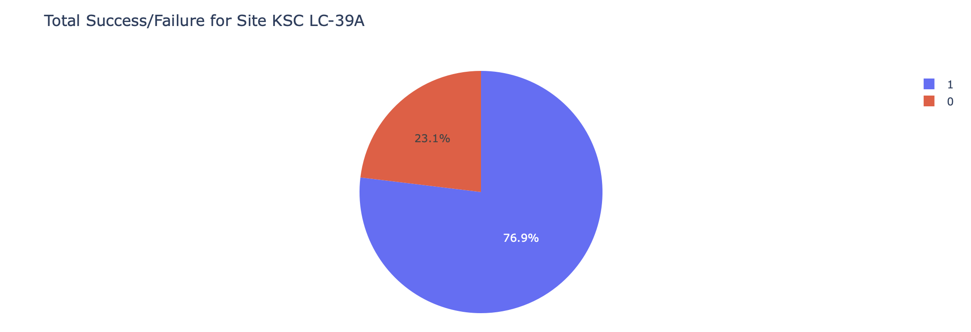
<Dashboard Screenshot 2>
We see that KSC LC-39A has achieved a 76.9% success rate while getting a 23.1% failure rate.

Slide 41
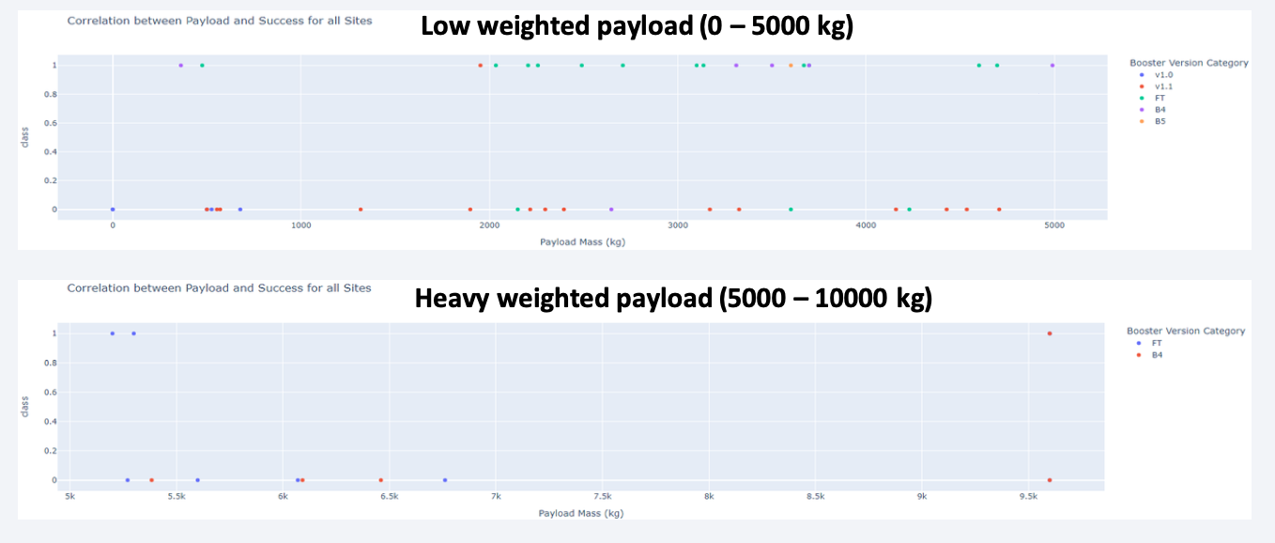
<Dashboard Screenshot 3>
Low-weighted payloads have a better success rate than heavy-weighted payloads.

Slide 42

Section 5

Slide 43
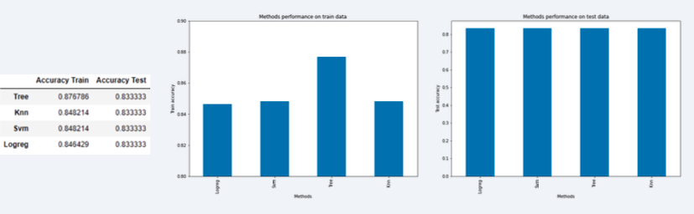
Classification Accuracy
If all models yield identical accuracy on the testing dataset despite varying training performance, it often indicates a small, simple, or imbalanced dataset. In such cases, accuracy alone may be insufficient, so it’s advisable to use additional metrics like Precision, Recall, F1-score, or ROC-AUC for better evaluation.

Slide 44
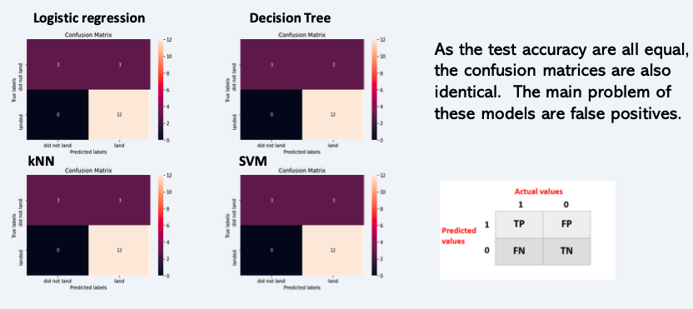
Confusion Matrix

Slide 45
Conclusions
• The success of a mission can be explained by several factors, such as the launch site, the orbit, and the number of previous launches. Indeed, we can assume that there has been a gain in knowledge between launches that allowed us to go from a launch failure to a success.
• The orbits with the best success rates are GEO, HEO, SSO, and ES-L1.
• Depending on the orbits, the payload mass can be a criterion to consider for a mission's success. Some orbits require a light or heavy payload mass. Generally, low-weight payloads perform better than heavy-weighted payloads.
• With the current data, we cannot explain why some launch sites are better than others (KSC LC-39A is the best launch site). To get an answer to this problem, we could obtain atmospheric or other relevant data.

Slide 46
Appendix
Include any relevant assets like Python code snippets, SQL queries, charts, Notebook outputs, or data sets that you may have created during this project

Slide 47


